Slide 1

Processes Concepts

Slide 2

Processes Concepts
Process Concept
Process Scheduling
Operations on Processes
Interprocess Communication
Examples of IPC Systems

Slide 3
Objectives
To introduce the notion of a process -- a program in execution, which forms the basis of all computation
To describe the various features of processes, including scheduling, creation and termination, and communication
To explore interprocess communication using shared memory and message passing

Slide 4
Process Concept
An operating system executes a variety of programs:
Batch system – jobs
Time-shared systems – user programs or tasks
Process – a program in execution; process execution must progress in sequential fashion
Multiple parts
The program code, also called text section
Data section containing global variables
Heap containing memory dynamically allocated during run time

Slide 5
Process Concept (Cont.)
Program is passive entity stored on disk (executable file), process is active
Program becomes process when executable file loaded into memory
Execution of program started via GUI mouse clicks, command line entry, etc
One program can be several processes
Consider multiple users executing the same program

Slide 6
Process State Diagram
As a process executes, it changes state
new: The process is being created
ready: The process is waiting to be assigned to a processor
running: Instructions are being executed
waiting: The process is waiting for some event to occur
terminated: The process has finished execution

Slide 7
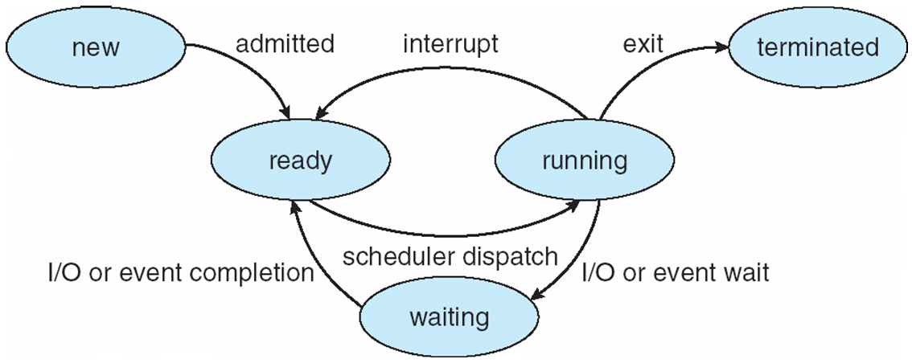
Process State Diagram

Slide 8
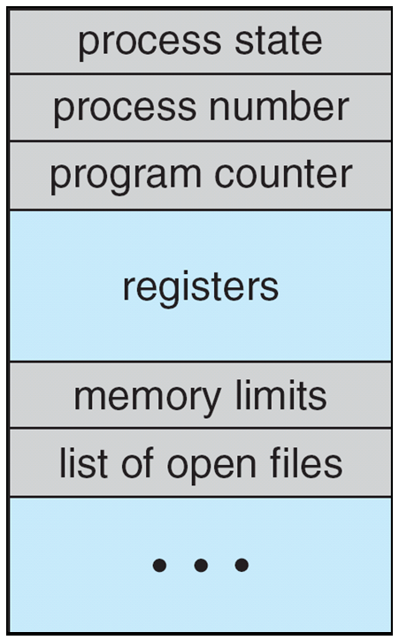
Process Control Block (PCB)
Information associated with each process
(also called task control block)
Process state – running, waiting, etc
Program counter – address of next Instruction
CPU registers – contents of all process-centric registers
CPU scheduling information- priorities, scheduling queue
Memory-management information – memory allocated to the process
Accounting information – CPU used, clock time elapsed since start, time limits
I/O status information – I/O devices allocated to process, list of open files

Slide 9
Threads
A thread is also called a lightweight process. Threads provide a way to improve application performance through parallelism. Threads represent a software approach to improving performance of operating system by reducing the overhead.

Slide 10
Difference between Process and Thread
S.N. | Process | Thread
1 | Process is heavy weight or resource intensive. | Thread is light weight, taking lesser resources than a process.
2 | Process switching needs interaction with operating system. | Thread switching does not need to interact with operating system.
3
4
5

